Slide 1
Welcome to A. P. U.S. History! Mr. Rob James Ms. Jen Sammons

Slide 2
Why Take A.P. Classes?
Students develop stronger writing, reading, note taking, and test taking skills.
Colleges look at difficulty of course load
A “C” in an A.P. looks better to colleges than an “A” in an Honors class
A score of a 3 or higher may count for college credit

Slide 3
Why take APUSH? (cont’d)
Students who take AP courses do better in college than those who do not.
1. Have already developed college-level writing, reading, and note-taking skills.
2. May bypass introductory-level college courses.

Slide 4
Why take APUSH?
It is the Gateway A.P. Course
Spend more time than other A.P. courses on basic skills needed for college:
Writing
Reading
Studying
Test-taking Group collaborative skills
Study group skills

Slide 5
The APUSH Course:
Learn How To Learn!

Slide 6
APUSH Exam: May 2023

Slide 7
Multiple Choice:

Slide 8
Multiple Choice

Slide 9
Short Answer

Slide 10
Document Based Question Essay

Slide 11
Long Essay Question

Slide 12
Essay Writing Focus

Slide 13
OneNote Online Binder

Slide 14
OneNote Online Binder

Slide 15
OneNote Online Binder

Slide 16
OneNote Online Binder

Slide 17
Seminar for Advanced Studies Course Goals:
Give direct support for students in the following areas:
Writing skills
Notetaking
Study Skills
Review Activities
Organization
Mentor & Goal Setting

Slide 18
Get extra support for studying!

Slide 19
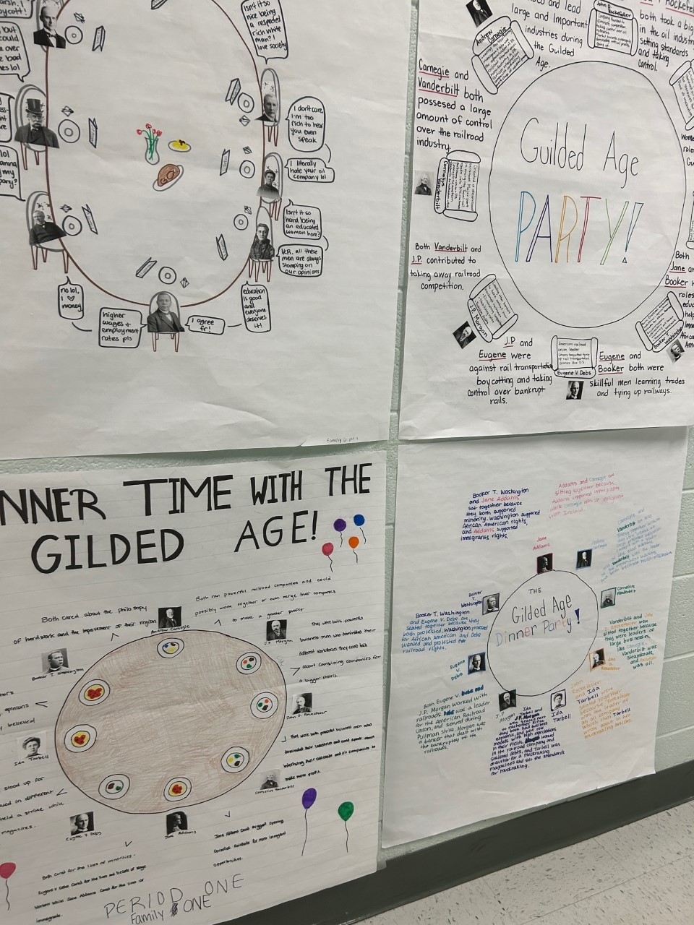
Let’s hear from our students!

Slide 20
Please sign up for both courses!
Seminar for Advanced Studies | A.P. U.S. History
1225S | 2209
Thank you!

